Slide 1


AngularJS.
Security
NADZEYA SHEDAVA
OCTOBER 20, 2015

Slide 2
COURSE AGENDA
1. INTRO
Angular features
Bootstrap a project
2. CONTROLLERS & MARKUP
Organize code in controllers
Use build-in directives to control view
3. SERVICES
More domain logic to services
Facilitate single-responsibility principle
4. DIRECTIVES
Create own custom elements
Observe changes
Handle events
5. ROUTING
Create true SPA with routing
Use built-in functionality of Angular routing
6. SECURITY
Security scenarios
Work with access tokens
React to 401
Cross-site scripting attacks
Correct bind HTML
7. DEBUGGING & DIAGNOSTICS
Diagnostic and debugging
8. ANGULAR UI
Search for ready solutions
9. FORMS
Enjoy two-way binding
Validate your user input
Show messages
10. TESTING
Test controllers, services and directives
Do full end-to-end testing

Slide 3
MODULE AGENDA
1
Web-stack typical security risks
2
Cookies vs Tokens
3
Request Interceptors
4
Angular attack prevention

Slide 4
RISKS
Insufficient access controls
SQL Injections
DNS Hijacking
Man in the middle
CSRF – Cross-Site Request Forgery
XSS – Cross-Site Scripting

Slide 5


AUTHORIZATION
COOKIES
TOKENS
Sent with every request
Susceptible to CSRF
Difficult to use across domains
Offer more control, no forgeries
Work across domains
Require more code

Slide 6


TOKEN – RELOAD PAGE

Slide 7

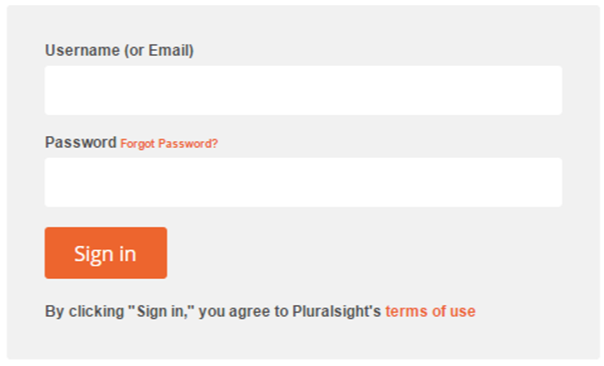

LOGIN AND REDIRECTS
GET /secret
GET /secret
redirect
redirect

Slide 8
$HTTP INTERCEPTORS
request
response
requestError
responseError

Slide 9
INTERCEPTOR EXAMPLE
$httpProvider.interceptors.push(['$q', '$location', '$localStorage', function($q, $location, $localStorage) {
return {
'request': function (config) {
config.headers = config.headers || {};
if ($localStorage.token) {
config.headers.Authorization = 'Bearer ' + $localStorage.token;
}
return config;
},
'responseError': function(response) {
if(response.status === 401 || response.status === 403) {
$location.path('/signin');
}
return $q.reject(response);
}
};
}]);

Slide 10
DEMO
{{ Token authentication }}

Slide 11
NG-BIND-HTML (NGSANITIZE)
STRICT CONTEXTUAL ESCAPING
$sce.trustAsHtml()
$sceProvider.enabled(false)

Slide 12
SCE DELEGATE PROVIDER
resourceUrlWhitelist
resourceUrlBlacklist

Slide 13
DEMO
{{ Sanitize }}

Slide 14
Q & A

Slide 15
Thank you
for your attention :)

